Slide 1
First, watch this video of how three physics visualizations in a circuit would be integrated below first:
http://www.lawschoolaids.com/flash_samples/E&M.mp4

Slide 2
You can also manipulate parts of the circuit using touch gestures and see how this affects numeric values of physics circuit equations and the various electron visualizations, see these examples in the next few slides…

Slide 3
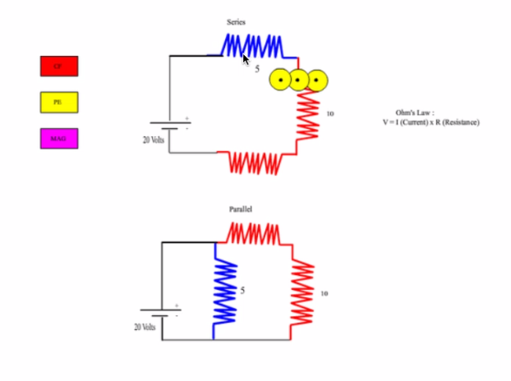
Ohm’s Law V=IR
You will be able to increase and decrease the voltage, or resistance on resistors and see how this affects the values of the Ohm’s Law equations and the potential energy visualizations by tapping on a battery, or swiping a resistor….

Slide 4
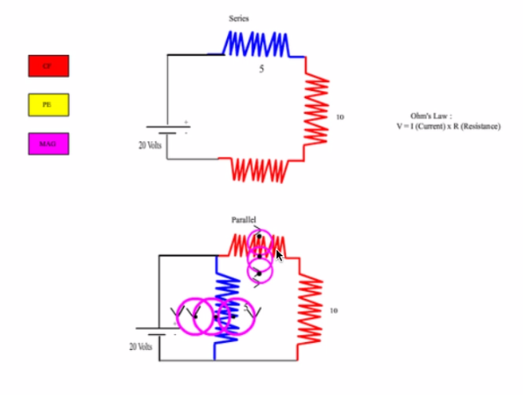
F= ilBsin(theta)
You will be able to increase and decrease the voltage, or resistance on resistors and see how this affects the values of the magnetic field on an electron equations and the magnetic field on an electron energy visualizations by tapping on a battery, or swiping a resistor….

Slide 5
Another example of the kinds of touch events used in the proposed circuit can be found in this simulation below:
http://www.lawschoolaids.com/flash_samples/capacitor0_1.swf

Slide 6

There will be visualizations where you can see how changes in this circuit would affect the LCD screen of a smartphone, making it brighter (i.e. more voltage/resistance), or less bright (less voltage/resistance):

Slide 7
You will do small questions as you go along and explore the circuit app on your own. You will think about what the answer is and then perform guiding exercises on the circuit to see if you’re right/what happens. Some examples of questions are:
What do you think you need to do to in the circuit to make the Iphone screen brighter?
What do you think increasing the resistance in the circuit will do to potential energy of the electrons in the various circuits?
*The app will tell you the correct answers as you answer them as you go along using the simulation

Slide 8
You will also do some numeric physics problem solving questions and conceptual questions, during using the app and afterwards as a quiz such as:
If you increase the voltage, what happens to the resistance if the current is constant? V=IR
If V=10 in this circuit, and the resistance is increased by 2, what will happen to the current?
If the current is increased by 4, how much will the voltage increase for the electrons in the circuit if the resistance is constant, and why?
You will get a grade and feedback on the correct answers for each quiz unit when you are finished..

Slide 9
Another description of how a student would use this app
For physics students wishing to supplement their instruction of the circuits unit of physics, they would install the application on their tablet at home, and would use the app to learn more visually and interactively key circuit concepts as they learned them in their electricity and magnetism unit in class. Adult supervision would not be necessary. Students could use the app anytime they wish and for however long they wanted to each session. They could also use the circuit app to pre-learn key concepts before class, or the review concepts before exams. Students would follow audio exercises to perform guided exercises for the major circuit concepts. They could also use the exercise book as described above and freely explore the circuit simulation as they wished.

Slide 10
Another description of how a teacher would use this app
Physics teachers who wish to integrate this circuit app into classroom instruction would purchase a license for all tablets in their classroom, and would watch a professional training video demonstrating how to use and implement the apps. They would also receive a teacher’s version of the exercise guidebook which would be very similar to the student’s version. There are many ways the teacher could integrate the app into classroom instruction, allowing them to maximize their creativity as instructors. They could have the students freely explore using the circuit app before they begin their circuits unit in order to get a general idea of how all the major circuit concepts are linked together. Then they could teach their planned lessons for this unit and have the students refer to the app and perform the guiding exercises and assessment questions for each concept in class whenever each physics concept was being taught. The students could then freely explore the circuit at the end of the unit as well after they’ve been formally taught all the physics concepts in lecture and gone through all the guiding exercises and assessment questions for the app. Teachers who allow students to take home their tablets, could also allow students to perform the guiding exercises and assessment questions for each unit as homework in preparation for teaching each physics concept in class, or alternatively as homework afterwards. The teachers would have access to all the students’ scores on their tablet version of the app for review. These are the major ways a physics teacher could supplement their classroom instruction by integrations the circuit app into their electricity and magnetism lectures on circuit theory.

Slide 11
Now download the assessment sheet, fill out and upload to mturk.com
Assessment can be downloaded here:
http://www.lawschoolaids.com/circuit/

